Slide 1

Deep Learning: Assignment-2
Dayanand Sagar University
Name- Aman Thapa
USN- ENG19CS0026
Section- A

Slide 2
Implementation of DNN
Github Link-
https://github.com/aman-thapa/DeepLearning-College/blob/main/Linear_regression_and_classification_in_DL.ipynb
Google Collab-
https://colab.research.google.com/drive/1FXR3jYGsgaJEqp2YKIW2_rc4WYEIpes4?usp=sharing

Slide 3
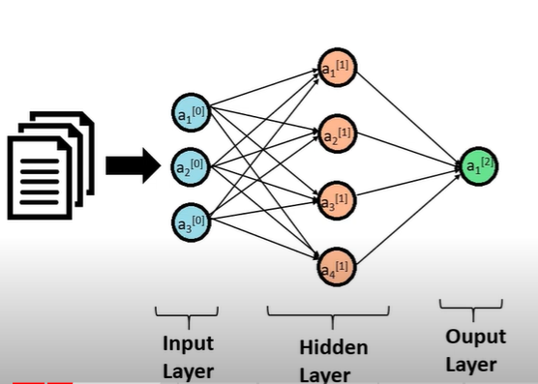
Forward and Backward Propagation
Forward Propagation is the way to move from the Input layer (left) to the Output layer (right) in the neural network.
The process of moving from the right to left i.e backward from the Output to the Input layer is called the Backward Propagation. Backward Propagation is the preferable method of adjusting or correcting the weights to reach the minimized loss function.

Slide 4
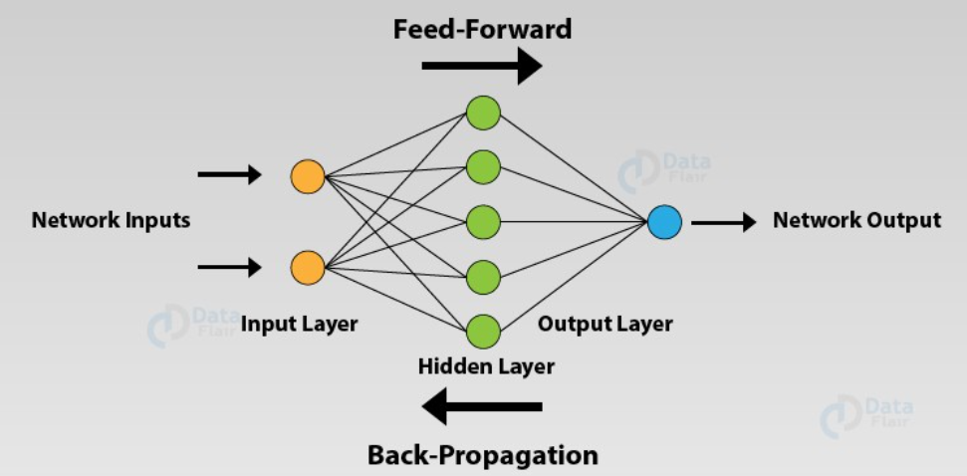

Slide 5
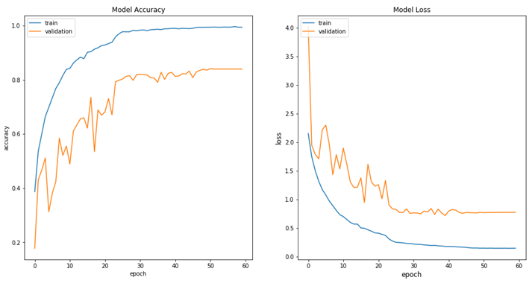
Loss and Metrics
Loss - Loss functions show a measure of model performance. They’re used to train a machine learning model (using some kind of optimization like Gradient Descent), and they’re usually differentiable in the model’s parameters.
Metrics - Metrics are used to monitor and measure the performance of a model (during training and testing), and don’t need to be differentiable.

Slide 6

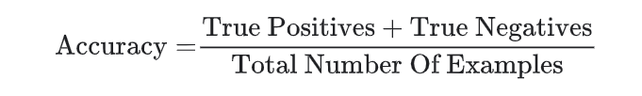
Accuracy
The fraction of predictions that a classification model got right. In multi-class classification, accuracy is defined as follows:
In binary classification, accuracy has the following definition:

Slide 7
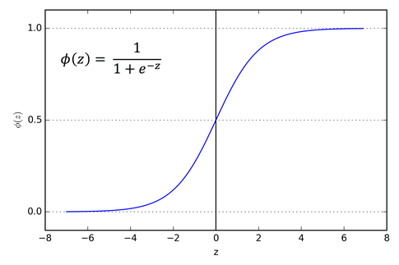
Sigmoid Function
The main reason why we use sigmoid function is because it exists between (0 to 1). Therefore, it is especially used for models where we have to predict the probability as an output. Since probability of anything exists only between the range of 0 and 1, sigmoid is the right choice.

Slide 8
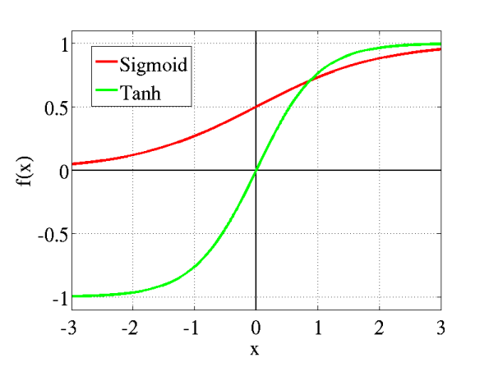
tanh function
tanh is also like logistic sigmoid but better. The range of the tanh function is from (-1 to 1). tanh is also sigmoidal (s - shaped).

Slide 9
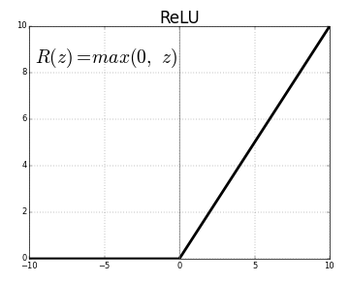
ReLu Function
The ReLU is the most used activation function in the world right now.Since, it is used in almost all the convolutional neural networks or deep learning.
As you can see, the ReLU is half rectified (from bottom). f(z) is zero when z is less than zero and f(z) is equal to z when z is above or equal to zero.
Range: [ 0 to infinity)

Slide 10
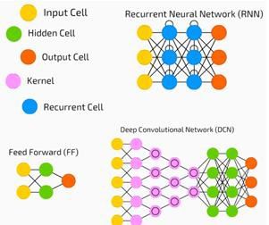
Deep Neural Network
A deep neural network (DNN) is an ANN with multiple hidden layers between the input and output layers. Similar to shallow ANNs, DNNs can model complex non-linear relationships.
The main purpose of a neural network is to receive a set of inputs, perform progressively complex calculations on them, and give output to solve real world problems like classification.

Slide 11
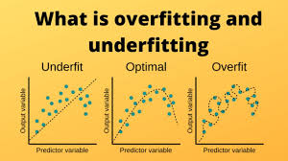
Overfit, Underfit and Optimal fit
Overfit- Overfitting refers to a model that models the training data too well. Overfitting happens when a model learns the detail and noise in the training data to the extent that it negatively impacts the performance of the model on new data. This means that the noise or random fluctuations in the training data is picked up and learned as concepts by the model. The problem is that these concepts do not apply to new data and negatively impact the models ability to generalize.

Slide 12
Underfit- Underfitting refers to a model that can neither model the training data nor generalize to new data. An underfit machine learning model is not a suitable model and will be obvious as it will have poor performance on the training data.
Optimal fit- Ideally, the case when the model makes the predictions with 0 error, is said to have a good fit on the data. This situation is achievable at a spot between overfitting and underfitting. In order to get a good fit, we will stop at a point just before where the error starts increasing. At this point, the model is said to have good skills on training datasets as well as our unseen testing dataset.

Slide 13
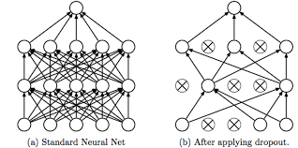
Dropout
A form of regularization useful in training neural networks. Dropout regularization works by removing a random selection of a fixed number of the units in a network layer for a single gradient step. The more units dropped out, the stronger the regularization. This is analogous to training the network to emulate an exponentially large ensemble of smaller networks

